Slide 1
RED DEAD REDEMPTION
Đoàn Minh Khánh - D19M02
Vũ Quốc Khánh - D19M02
Huỳnh Đức Huy - D19M02

Slide 2
THE STORY
The game's plot is contrary to the romantic visions of a free West, the Red Dead Redemption storyline is much darker with a lot of death scenes. It began in 1899, when the Dutch-led Van der Linde gang was on the run to escape the U.S. government's pursuit, because they had just made a huge incident in the city of Blackwater. Dutch led his men to the northern mountains to try to escape and wait for things to settle down. The game begins in the snowy mountains of Colter, the gang is hiding after the events of the Blackwater Massacre, with Dutch van der Linde and his right-hand man, Hosea Matthews, desperately trying to keep their gang free.
Gameplay Red Dead Redemption is a western action-adventure game set in an open world environment and played from a third-person perspective, featuring single-player and online multiplayer components. The game has new features absent from the previous game.

Slide 3
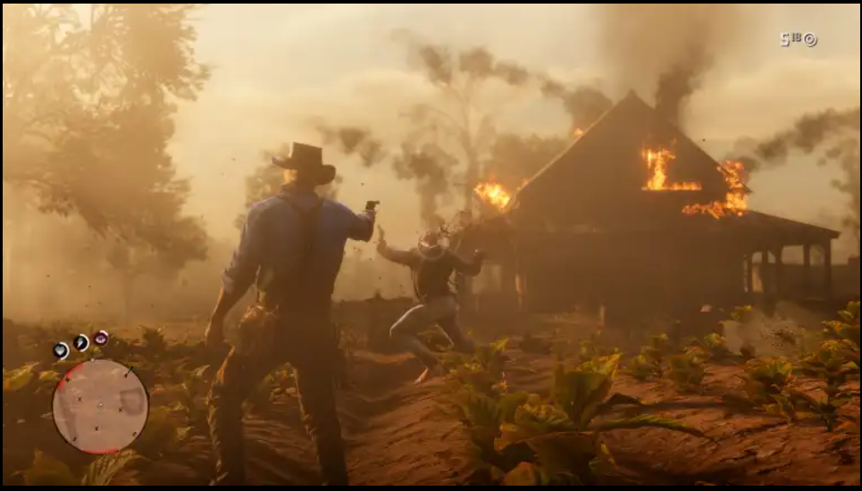
CONTROL MECHANISM
In-game controls:
Hit (hit with a pictured weapon with a knife etc. The user clicks the left mouse to control the character).

Slide 4
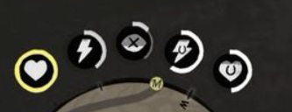
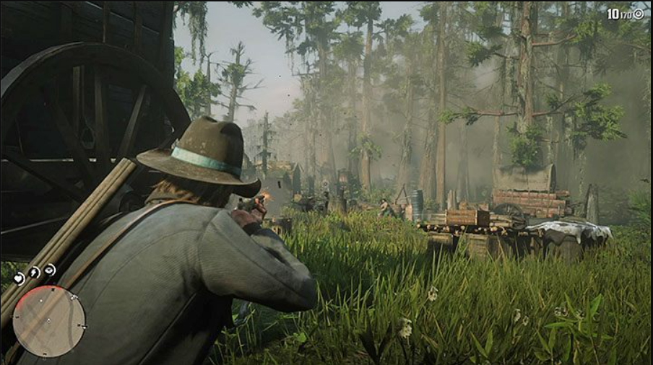
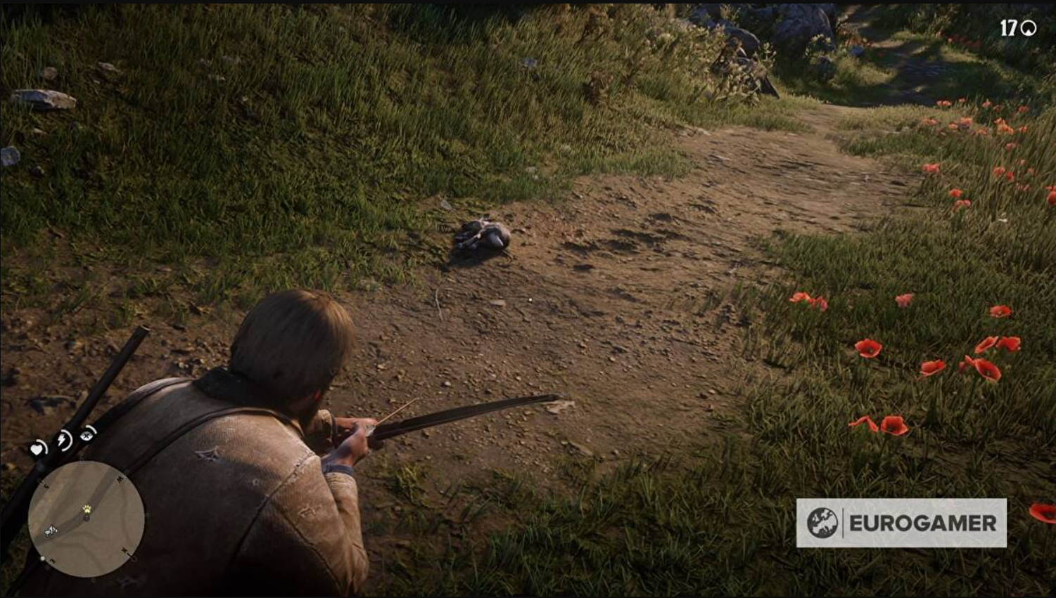
Energy cells (players pay attention to three points of blood, fitness, dead eye)
Aim the gun (the user right-clicks to aim the gun)
Bending over (users click control to perform the end of the person)
Horseback riding (users click H to ride horses and click shift to run fast)

Slide 5
TECHNICAL REQUIREMENTS
Physicality
The physics in the game is generally shown when the character flies up or jumps and falls, when the character runs and stops.
The physics in the game in particular is shown through different levels, because each character level will fight in each different terrain. For example, when the character fights where there is water, it will be difficult to move, it will be difficult to be slippery or when the character is in the domestic level, when moving will be subject to the resistance of water, so the move will also be slower than the levels on land.

Slide 6
Level of Play
The levels are divided according to the tasks assigned by the system to the player that promise to lead the player to experience the open world. Fight other gangs on missions.
Play scenario
New to play, you will be able to control Arthur's character by default and experience the story in the game. In addition, the character in the game will have blood index, physical loss in environmental conditions, hunger, .. This causes the player to go for food and drink water to ensure fitness.
Cheating while playing
When full of blood and full energy, even if you use more food or new energy, it does not increase.

Slide 7
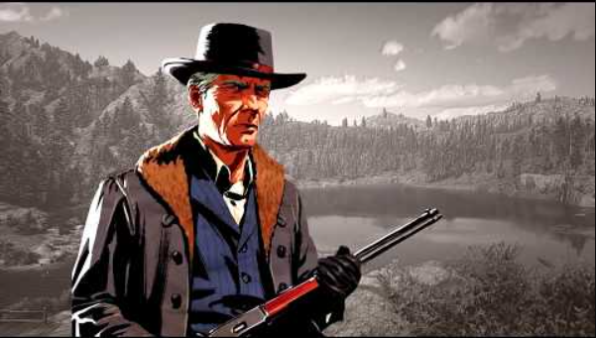
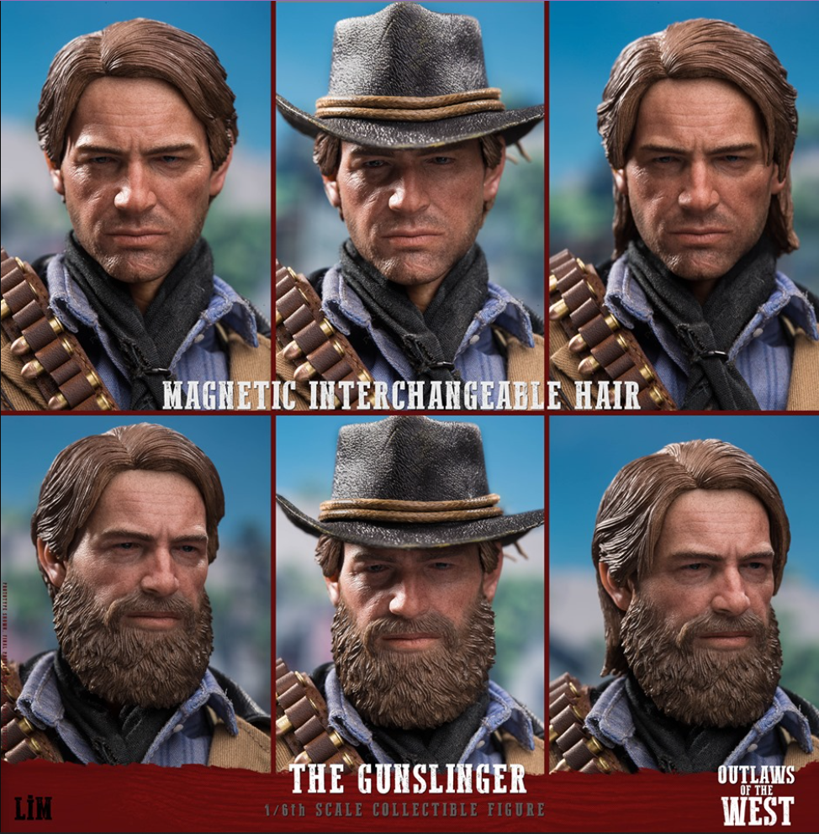
START SCREEN
Khi the player who selects to enter the game will show the start screen of the game. The game start screen has a loading interface then goes straight into the game.

Slide 8
GAME FLOWCHART
Players after doing all the missions can have a lot of money then choose to buy weapons, food, costumes, upgrade horses, upgrade weapons ... Through many missions, players can both experience the plot and upgrade weapons.

Slide 9
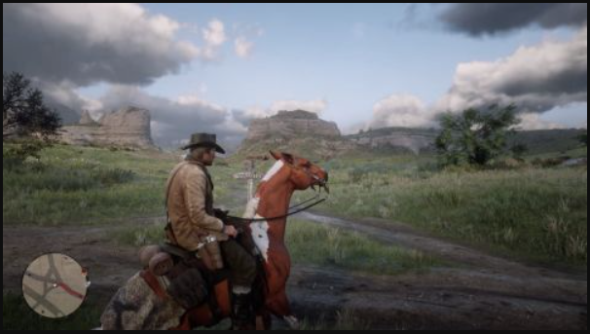
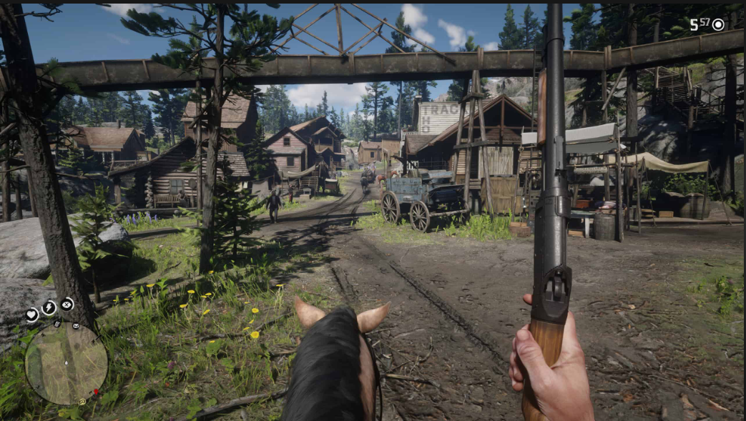
GAME CAMERA
Third person camera
With this perspective, players can easily observe the surrounding context to come up with avoidance tactics, provide timely handling as well as use appropriate weapons to be able to overcome the enemies and obstacles in front of them..

Slide 10
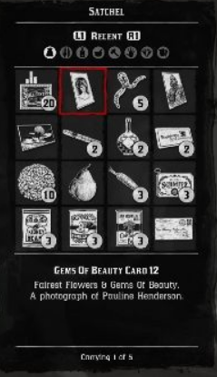
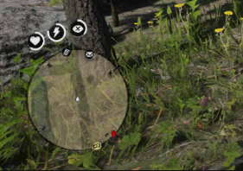
HUD SYSTEM
The information presented on the screen includes: Player's name, heart-shaped yellow blood bar and energy bar, basket of items the player buys, the number of bad diamonds, the number of diamonds that the player is obtaining, option buttons, pause buttons, character movement buttons, move buttons.
Heart-shaped blood bar and lightning-shaped energy bar: at the start of the game, the player will have 100% blood and 100% internal strength.
The basket contains items that the player buys and collects during the game. At the beginning, in the chest there will be 10 food and wine, money, diamonds.

Slide 11
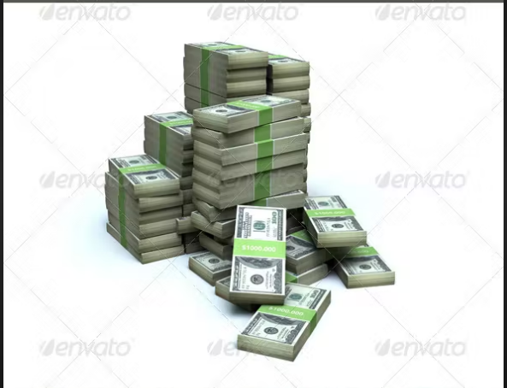
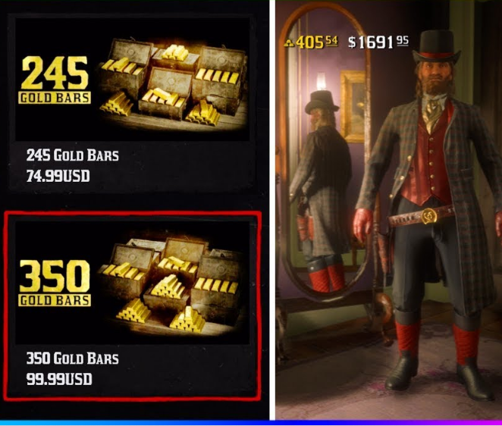
Currencies, diamonds:
The way to earn bad needles is to complete many tasks in the system and will be rewarded with gold coins according to the difficulty.

Slide 12
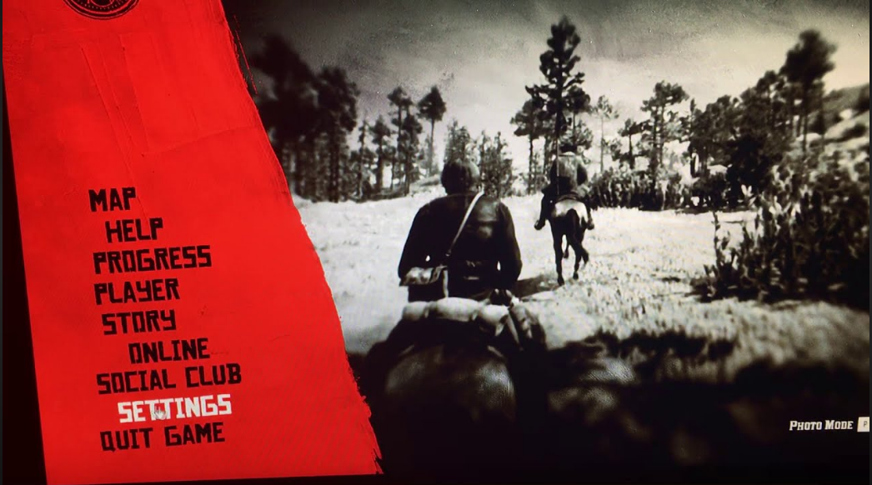
Pause game will display the option screen showing information such as Map, Help, Process…
The buttons to move the character: fly up, go forward, back you can do 2 operations at the same time that is press the fast button.
Skill-performing buttons: press the left mouse ferociously to turn on the slow rotation then perform the enemy shot.
Recovery: When your blood or energy is less than 100%, it will be used. Each food will recover 20% of the blood or energy.

Slide 13
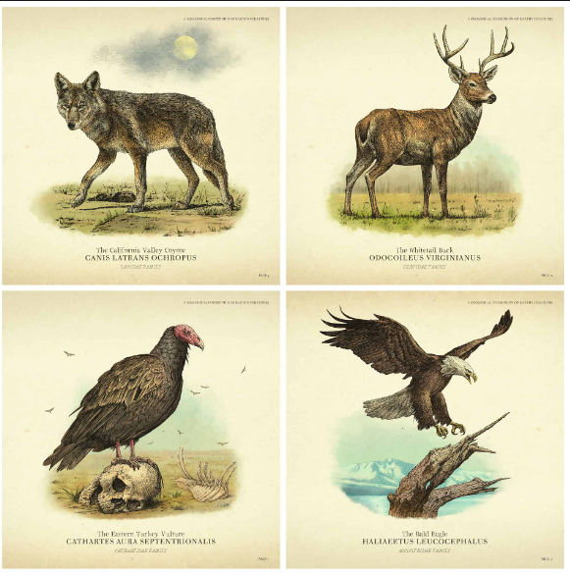
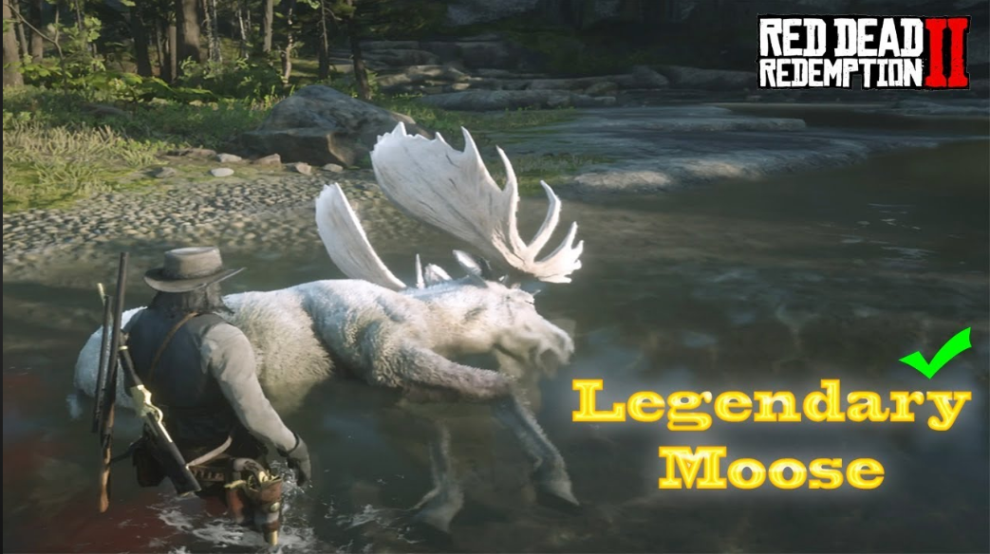
PLAYER METRICS
The size of the player and the monster will depend on the weak strength of the monster, in addition to the animal, there are legendary animals, the size will be very large and bring high value.
e
The size of the person compared to the boss

Slide 14
PLAYER SKILLS
At the beginning of the game, players will also be given 100% blood and 100% energy. 1 simple weapon (rifle) and 1 rope, 1 dagger, camping suit, explosives, pistol ...
Weapon:
Weapon : Depending on the type of weapon, it will help the character increase the attack power and the target quickly die
Moves: The player will have a skill called dead eye, which helps players prepare well before shooting, then shoot at high speed.

Slide 15
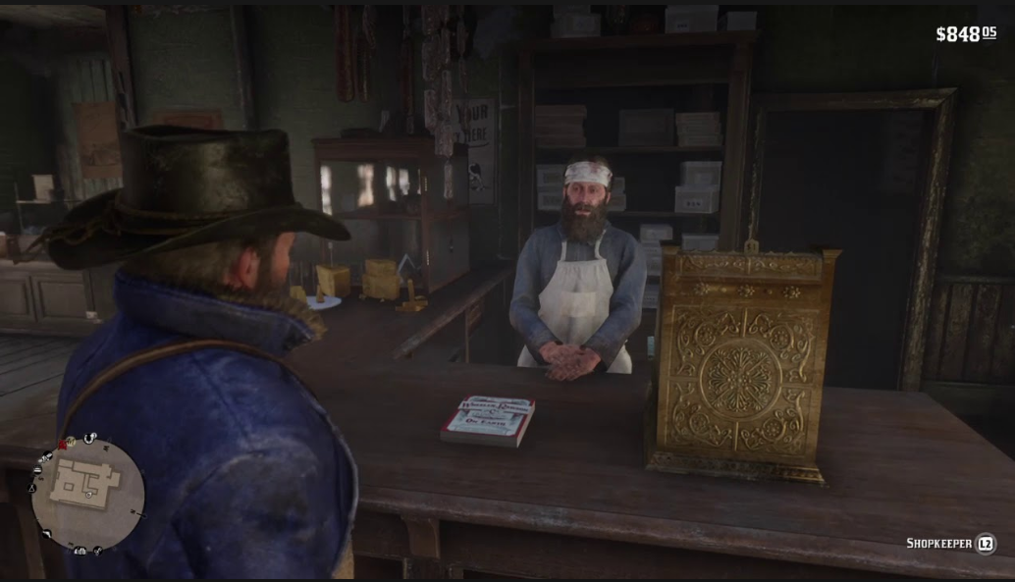
PLAYER INVENTORY TOOLS
To buy weapons, skills, mission personnel, pay the task you need to go to the NPC
When meeting npc on the map, players can choose a variety of services depending on the function of the npc.
When you complete the task, the npc will come out to thank you and tell their story.

Slide 16
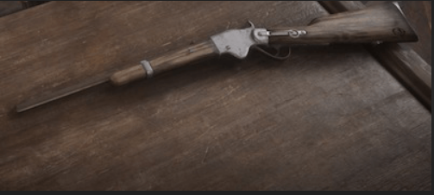
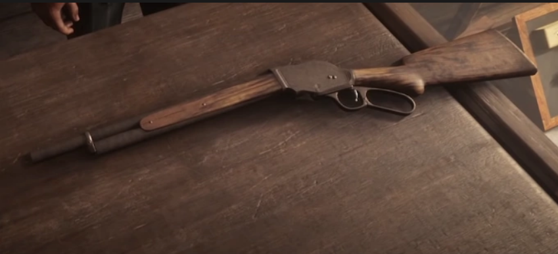
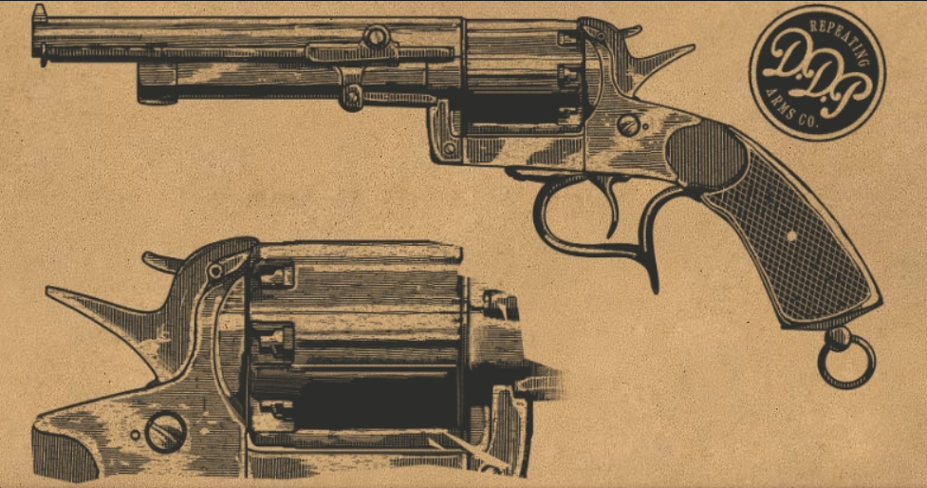
Carbine Repeater: A reliable and popular repeating rifle, the Buck Carbine provides medium damage and a decent firing rate, with quick reload speeds thanks to the tube-loaded magazine in the weapon's stock.
Repeating Shotgun: The Lancaster Repeating Shotgun is a well-rounded gun that uses the same lever-action system commonly found on repeating rifles. The large ammo capacity gives the shooter the luxury of accuracy while maintaining the power ideal for close-quarter encounters.
LeMat Revolver: The LeMat is a cap and ball revolver with a single-shot, smooth bore barrel of buckshot beneath the main barrel, allowing players to switch between revolver and shotgun ammunition at their leisure.

Slide 17
Food
Coffee Moderately restores Stamina Core and Dead Eye Core
Minty Crustacean Crustacean Meat x1 Wild Mint x1 Greatly restores Health Core, moderately restores Stamina Core and Dead Eye Core
Minty Exotic Bird Exotic Bird Meat x1 Wild Mint x1 Fully restores Health Core, greatly restores Stamina Core and Dead Eye Core…

Slide 18
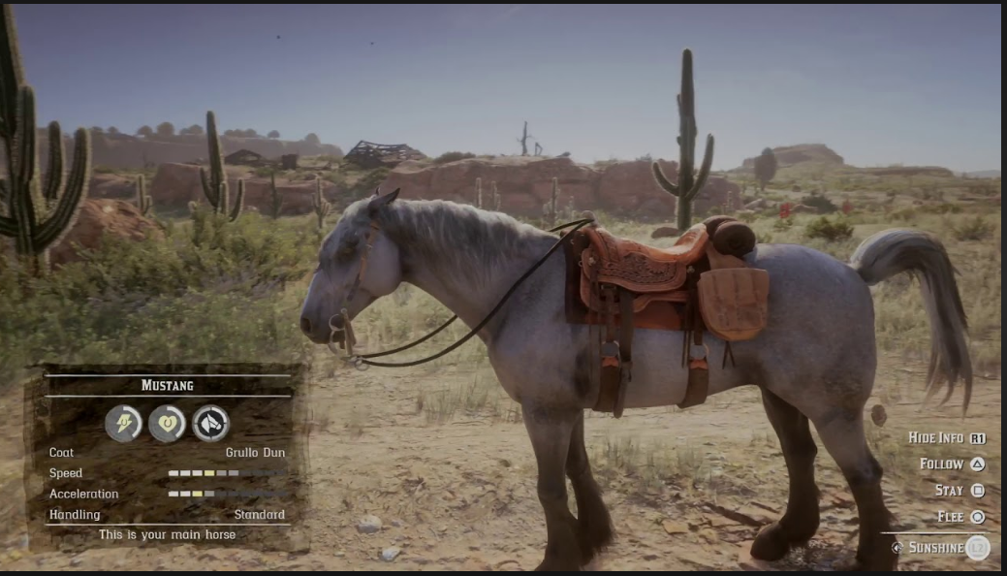
VEHICLES
Horse: will be a means of transportation in the game, when the character needs transportation, will whistle this will bring the horse if the horse is nearby
Blood will determine the health of the horse.
Physical strength: will determine the speed of the fishing.
Reliability: the higher this means that when you whistle even far away, the horse will follow.

Slide 19
QUEST SYSTEM
+ Chapter 1: Colter - After a failed robbery, the gang have fled from Blackwater into the Grizzly Mountains, but a late spring storm has left them half frozen and starving. They hole up in an abandoned mining town to lick their wounds and await a break in the weather.
+ Chapter 2: Horseshoe Overlook - After a break in the weather, the gang have headed down from the mountains, and are now hiding at Horseshoe Overlook.
+ Chapter 3: Clemens Point - The gang got run of Valentine after an altercation with the railway magnate, Leviticus Cornwall, who has grown tired of having his trains robbed by gangs of outlaws.
+ Chapter 4: Saint Denis - Things ended poorly in Rhodes. The Pinkertons showed up again, and little Jack Marston is kidnapped. The gang headed to Saint Denis hunting for Jack and are now hiding outside town, deep in the swamps, in a rundown old manor house called Shady Belle.
+ Chapter 5: Guarma - The bank robbery in Saint Denis was a disaster. The gang has been almost destroyed, several members were killed and arrested. Everything seemed lost. Dutch, Micah, Javier, Bill and Arthur escaped on a boat. The boat sank in the Carribean and they were washed ashore on the island of Guarma, a sugar cane producing island off the coast of Cuba.
+ Chapter 6: Beaver Hollow - The gang, or what is left of it were reunited at Lakay, but was quickly assaulted by a squad of Pinkertons. The gang fled into some dangerous county to the north and are now hiding in Beaver Hollow, awaiting their fate and riddled with internal disputes and anxieties. Arthur is not feeling very well and is unsure what to do.

Slide 20
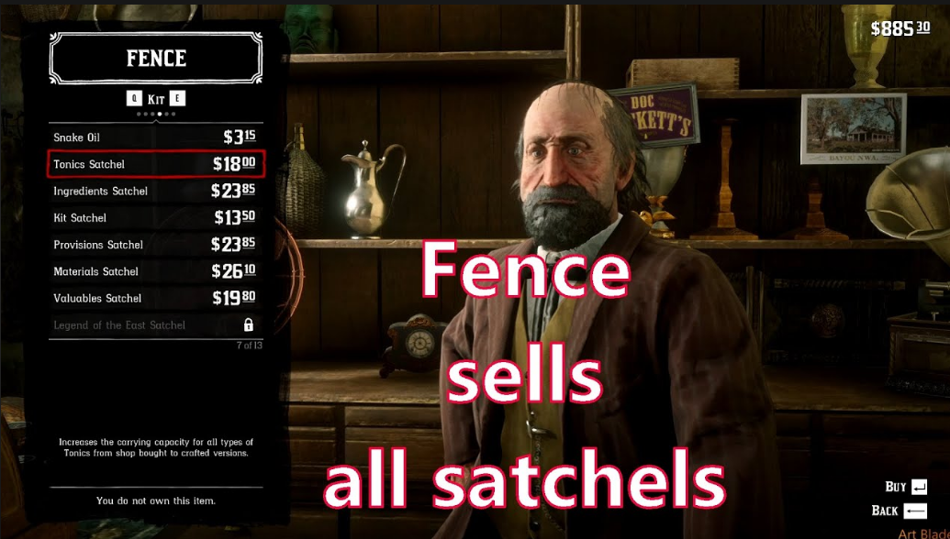
NPC
NPC will be the characters in the game, will be the one who assigns you the task, when you complete the task will be rewarded by this character. Or in the tasks you will have to defeat these npcs.
NPC sales: These characters will buy back the things you sell, and resell you the necessary necessities.
NPC task: These characters will assign tasks to you and when you complete them there will be rewards

Slide 21
MUSIC AND SFX
Sound effects are an important, indispensable part of any game. It contributes greatly to the effect as well as showing the nature of the whole game and in each scene.
The whole game will have a dominant music song, but in each game scene, when light, slow, when fiercely tough, the music will change the appropriate variation, when it is easy, when rushing fiercely.
In each move, when the player uses any old gas, there will be a characteristic noise of that weapon. It's accompanied by effects sounds that make the player really attracted.

